Slide 1
Living Environment
Do Now:
Move your desk
Take out:
Vocabulary Homework
Homework POGIL
Aim: Graphing
Homework:
POGIL: Analyzing Trends
FYI:
Unit Test: Friday September 12th
Lab:
Lab Safety Quiz Wednesday 9/10
Lab Safety Contract Signed

Slide 2
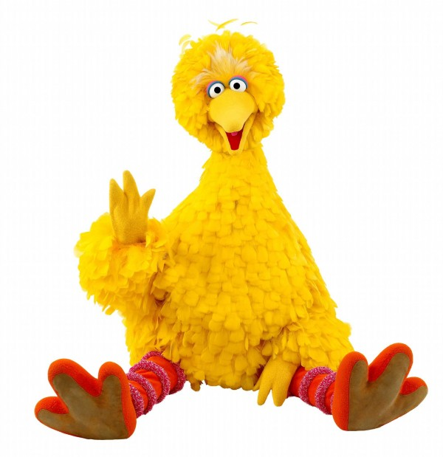
You are an ornithologist who studies the reproductive habits of a rare Galapagos finch, Big birdicus. You have noticed that there appears to be correlation between the eggs of this species at the protein content of their diet. What kind of information could you collect about the eggs of this species?

Slide 3
Information Gathered
Qualitative | Quantitative
Color Shape Texture Pattern Hardness Season of year eggs laid | Number of eggs Length of gestation Length Circumference Radius Width Density

Slide 4
Making a Claim
The diet of the bird will effect the egg that is produced

Slide 5
Forming a Hypothesis
If the bird eats a high protein diet, then the color of the eggs will be purple
If the bird eats a normal diet, then the color of the eggs will be normal

Slide 6
Designing an experiment
Control: a group of birds that eats a normal diet
Experimental Group: a group of birds that eats the experimental, high protein diet.
Independent variable: The variable that I the experimenter can control
The diet of the bird
Dependent variable: The variable that depends on the independent variable
Constant: Factors in the experiment that remain constant.

Slide 7
Collecting Data
Qualitative Data: description of qualities
Quantitative Data: numerical information
Data Table:
Independent Variable 1st
Dependent Variable 2nd
Used to organize information

Slide 8
Analyzing Data
Graphs:
Used to observe trends

Slide 9
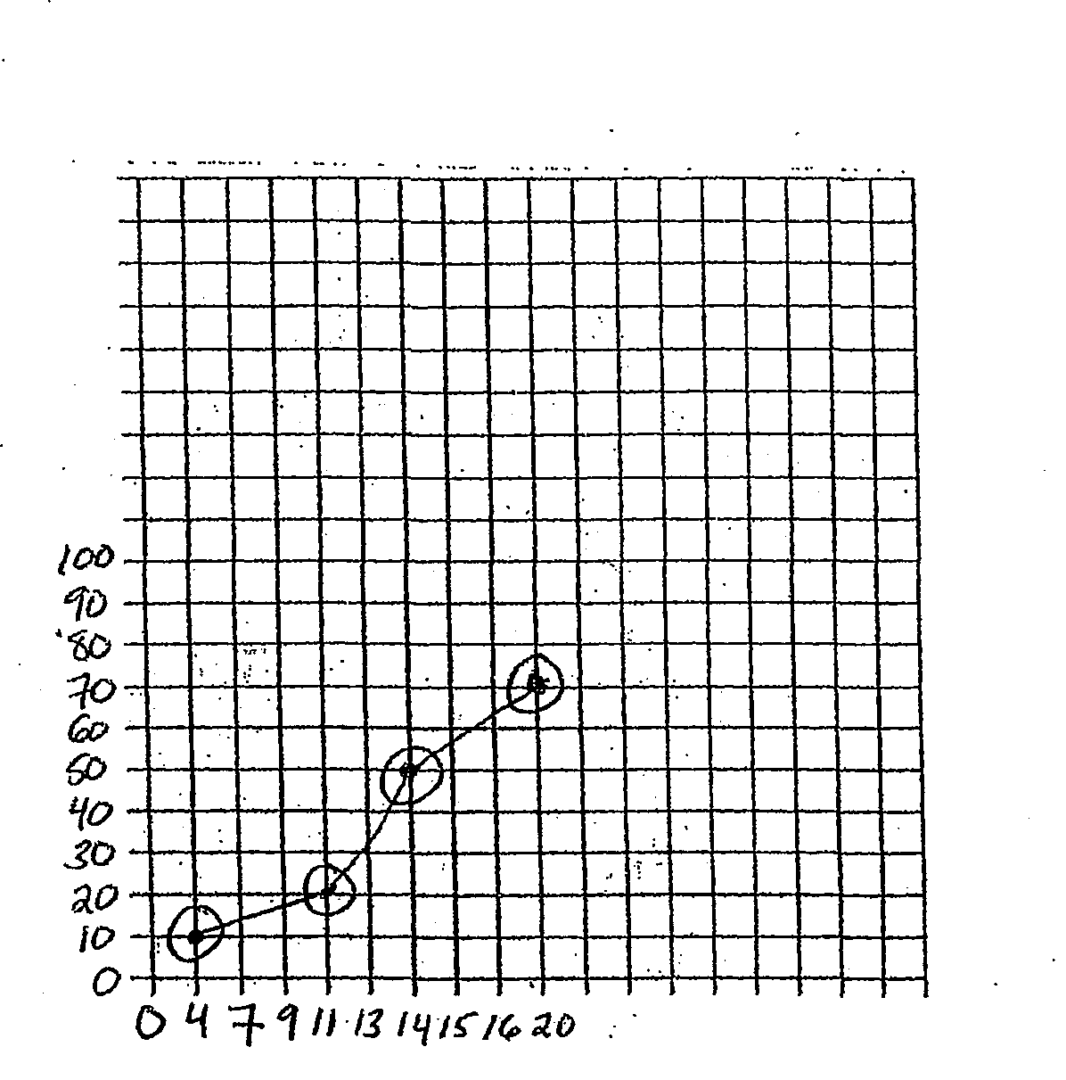
Analyzing Data

Slide 10
Analyzing Data

Slide 11
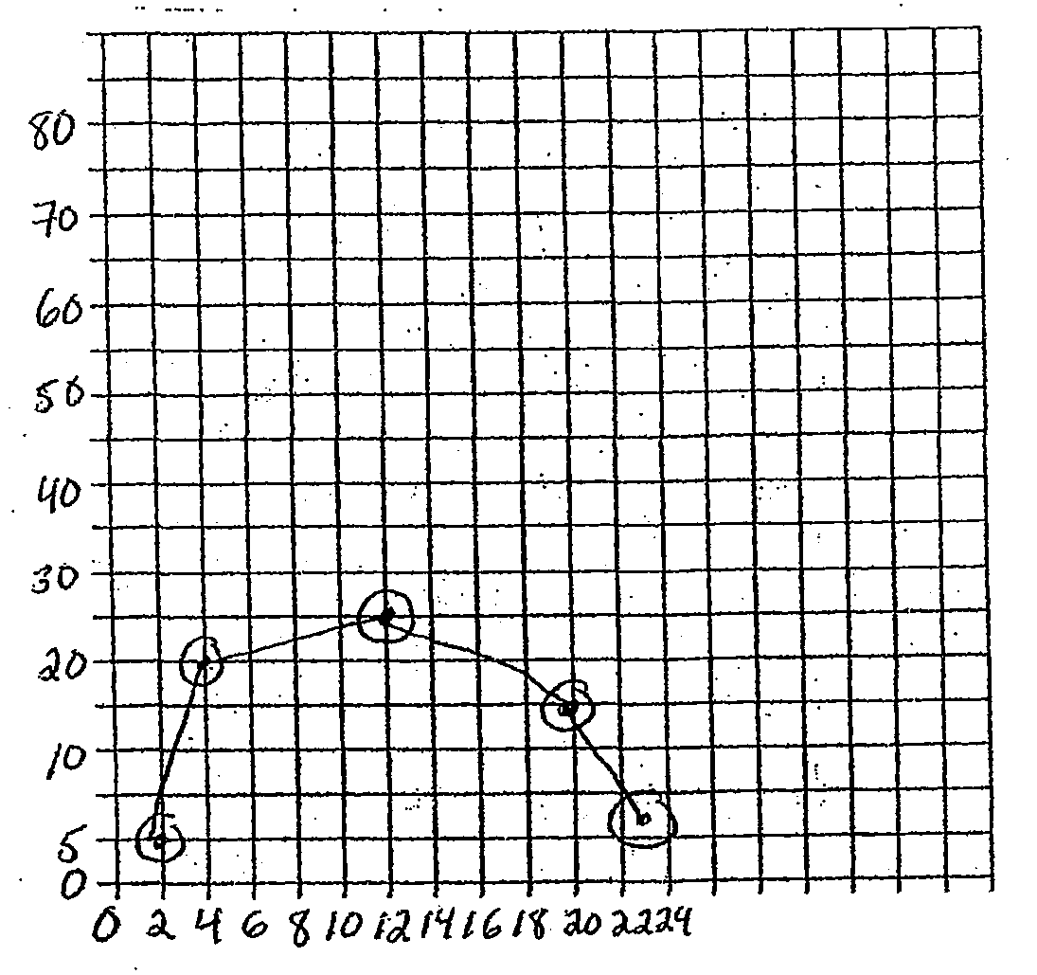
Analyzing Data

Slide 12
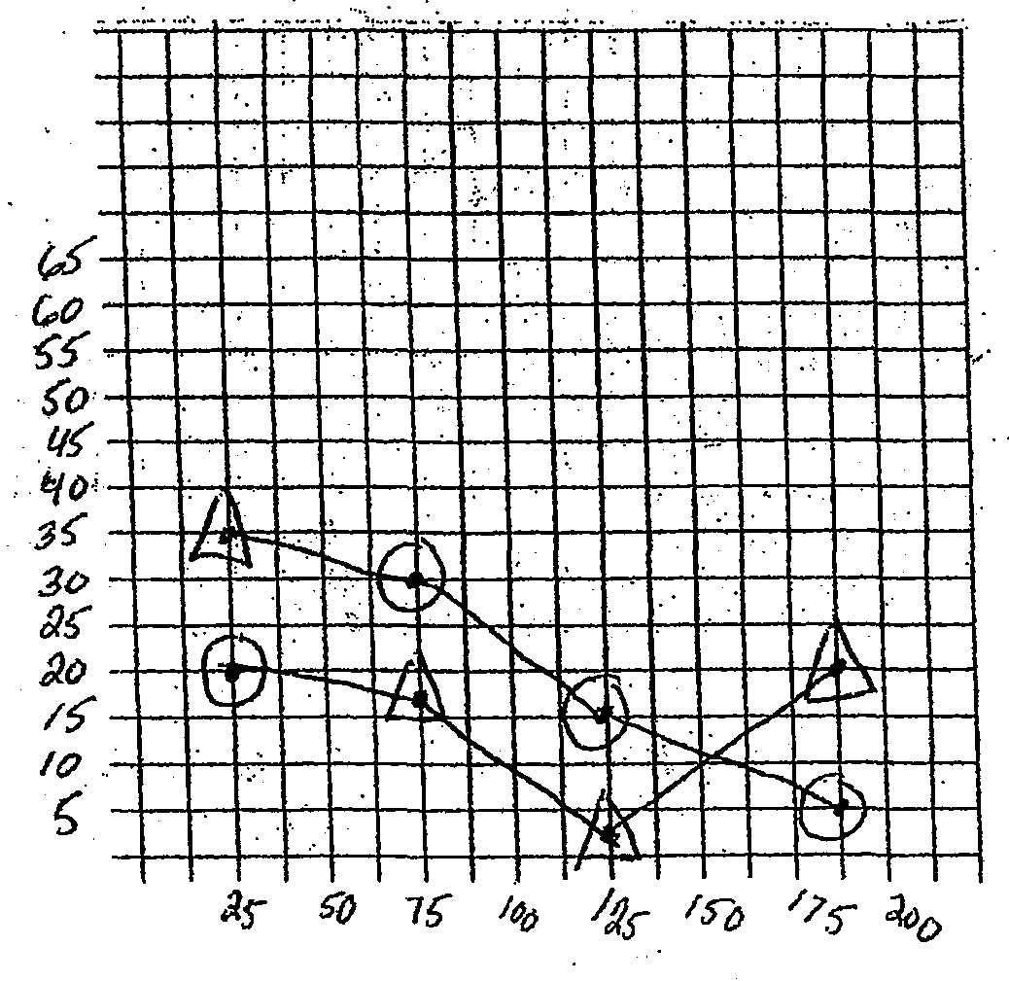
Analyzing Data

Slide 13
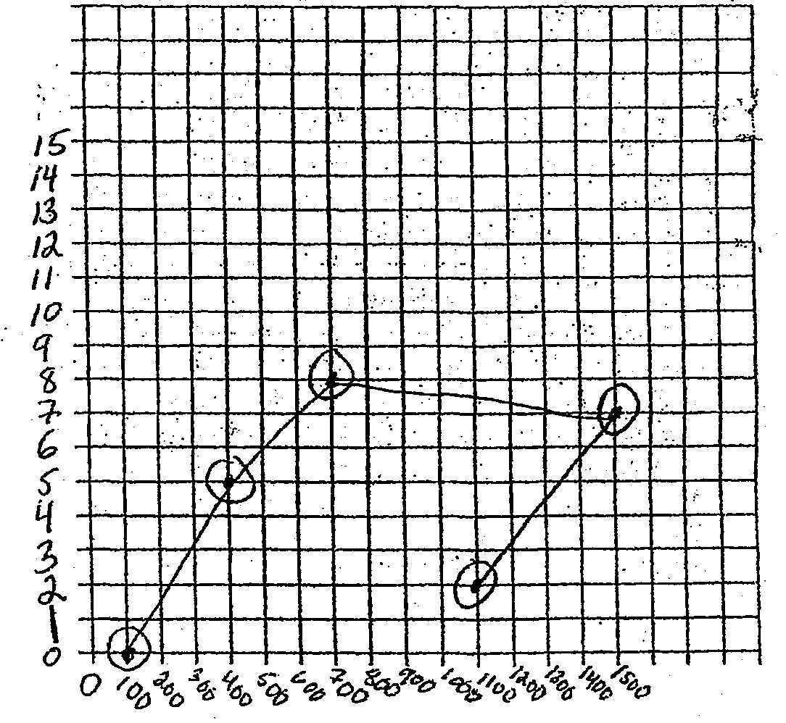
Analyzing Data

Slide 14
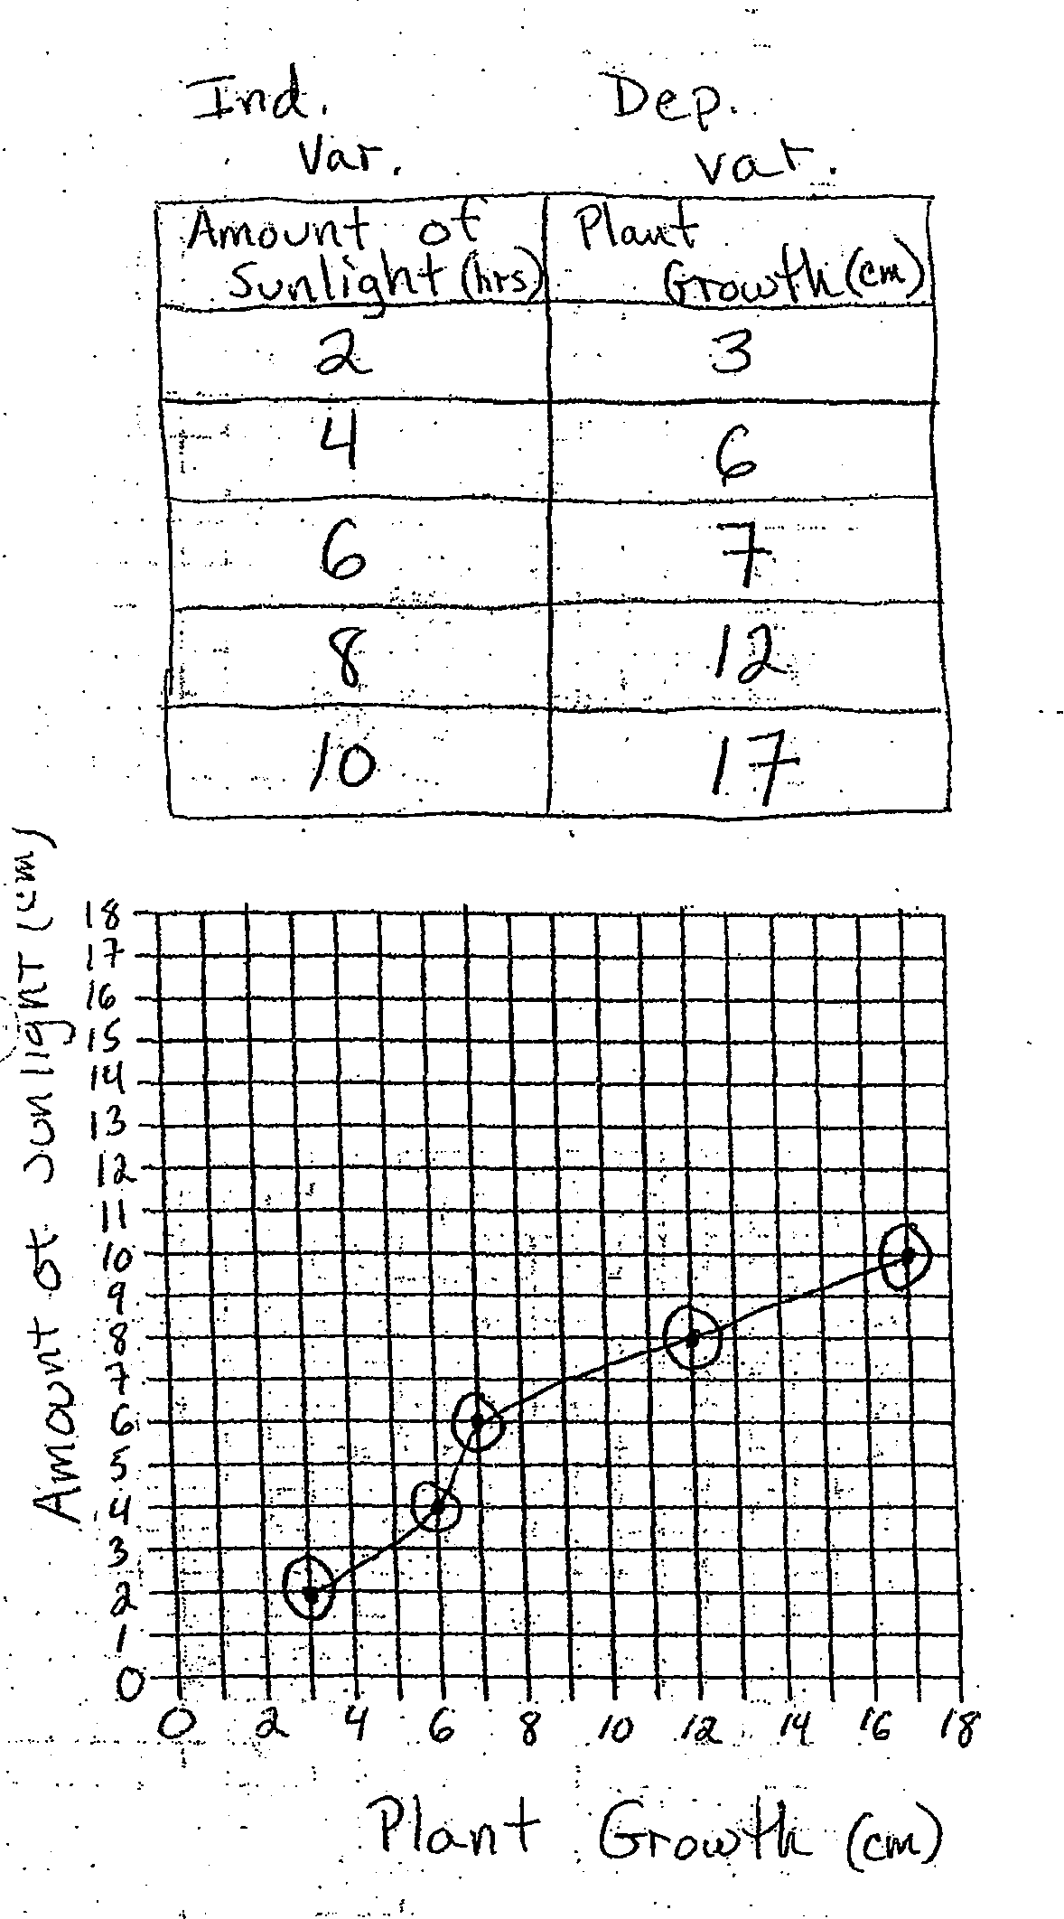
Analyzing Data

Slide 15
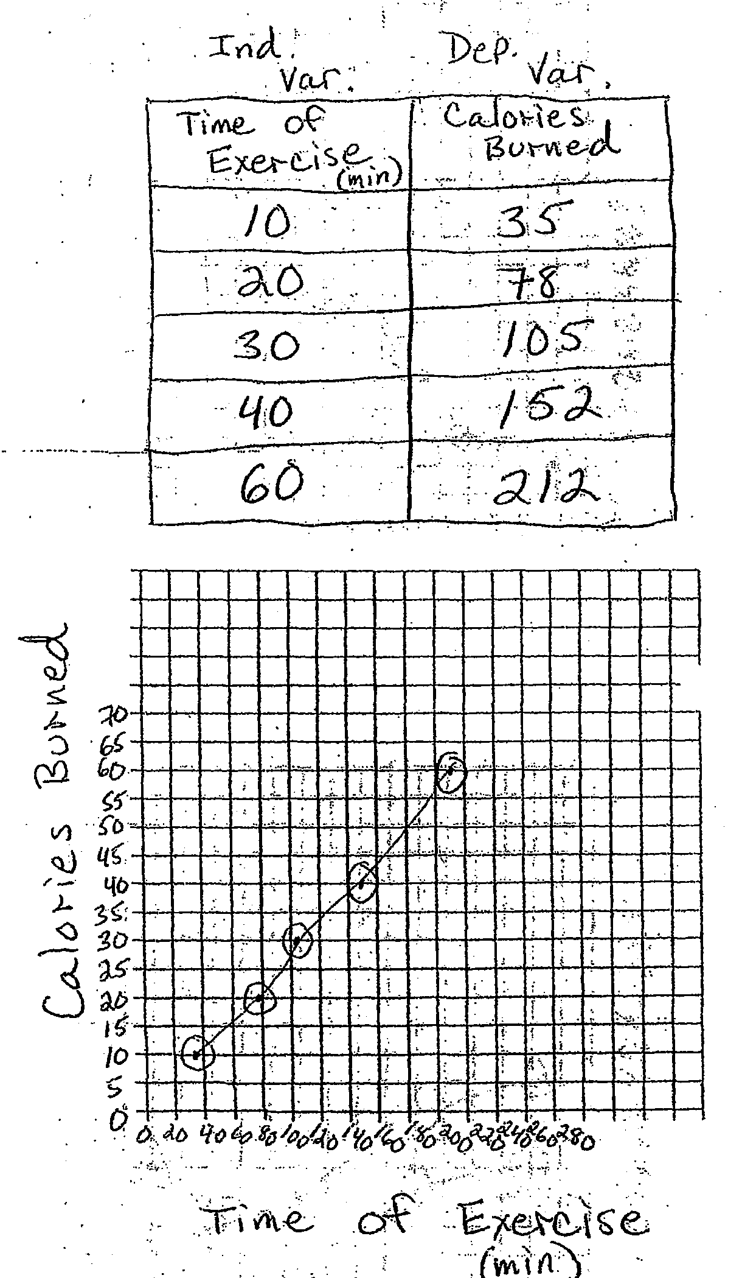
Analyzing Data

Slide 16
Analyzing Data
Every Graph should have the following:
Title
Axis
X axis
Y axis
Legend
Units

Slide 17
Reporting your findings

