Slide 1
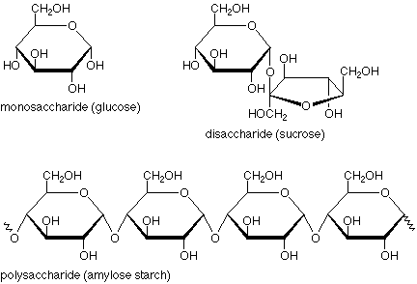
Carbohydrates
Organic Compounds made of Carbon, Hydrogen, Oxygen.
Carbon and Hydrogen in a 2:1 ratio.
Ring like structures
End with –ose
Examples
Glucose
Sucrose
Fructose
Maltose
Functions:
Used as food that is converted into energy through cellular respiration
Simple Building Block | Complex Structures
Monosaccharide Simple Sugars Glucose Fructose | Polysaccharide Starch Cellulose

Slide 2
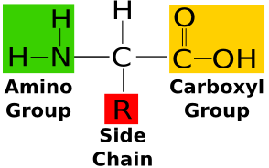
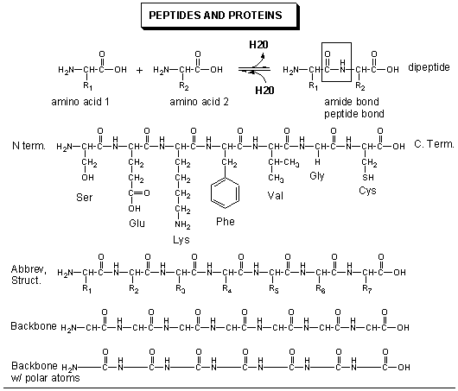
Proteins
Organic Compounds made of Carbon, Hydrogen, Oxygen, Nitrogen, and sometimes Sulfur
No Ratio of Elements
Composed of Amino Acids (monomer)
Examples
Hemoglobin
Enzymes
Structure/Function:
Sequence of amino acids (primary structure) folds the protein into specific shapes with alpha helixes and Beta Sheets (second structure). Tertiary structure, or overall shape allows proteins to have specific jobs. Some proteins work with other proteins (Quaternary Structure) to perform more complex jobs such as Hemoglobin.
Simple Building Block | Complex Structures
Mono-peptide Amino Acid | Polypeptide Protein

Slide 3
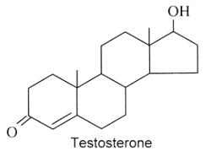
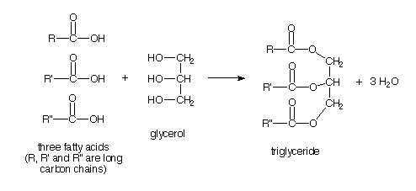
Lipids
Organic Compounds made of Carbon, Hydrogen, and Oxygen
No Ratio of Elements
Composed of one Glycerol and 3 Fatty Acids
Examples
Fats, Oils, Waxes
Steroids, Hormones
Structure/Function:
One Glycerol and 3 Fatty Acids (building blocks) combine to make one Lipid.
Steroids have multiple fused rings.
Simple Building Block | Complex Structures
1 Glycerol 3 Fatty Acids | Lipid Triglycerol

Slide 4
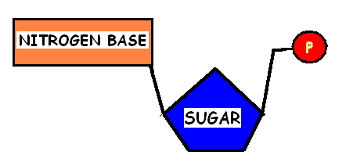
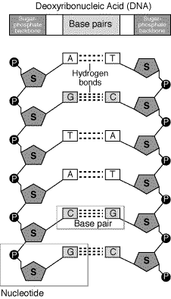
Nucleic Acids
Organic Compounds made of Carbon, Hydrogen, Oxygen, Nitrogen, and Phosphorous
No Ratio of Elements
Composed of one phosphate group, sugar ring, and nitrogenous base. Combined, it is called a nucleotide.
Examples
DNA (Deoxyribonucleic Acid) RNA (Ribonucleic Acid)
Structure/Function:
Hereditary Material
DNA is made of deoxyribose sugar. Nitrogenous bases are A,T,C,G
RNA is made of ribose sugar. Nitrogenous bases are A,U,G,C
Simple Building Block | Complex Structures
Nucleotide | Nucleic Acid RNA DNA

Slide 5
Lipids
Organic Compounds made of Carbon, Hydrogen, and Oxygen
No Ratio of Elements
Composed of one Glycerol and 3 Fatty Acids
Examples
Fats, Oils, Waxes
Steroids, Hormones
Structure/Function:
One Glycerol and 3 Fatty Acids (building blocks) combine to make one Lipid.
Steroids have multiple fused rings.
Simple Building Block | Complex Structures
1 Glycerol 3 Fatty Acids | Lipid Triglycerol

